Slide 1
Chapter Four State, Government and Citizenship
Understanding State

Slide 2
4.1. Defining State
The term ‘’state‘’ has been incorporated wide range of things such as a collection of institutions, a territorial unit, a philosophical idea, an instrument of coercion or oppression, and so on.
So, this confusion stems, in part, has been defined in four quite different approach.
The idealist approach: is defined by Hegel he was identified three moments of social existence of state: the family, civil society and the state.
He also conceived the state as an ethical community by mutual sympathy as ‘’universal altruism’’( general well-being selfless) to develop state.

Slide 3
Functionalist approaches:- to the state focus on the role or purpose of state &institutions.
The central function of the state seen as the maintenance of social order.
This approach defined state as the set of institutions that uphold social order and deliver of social stability.
The organizational approaches:- defines state as the apparatus of government in its broadest sense; set of institutions that are recognizably by public are responsible for the collective organization of social existence and are funded at the public‘s expense.

Slide 4
Cont.
The state comprises (covered) the various institutions of government: these are bureaucracy, the military, the police, the courts, and the social security system and so on; it can be identified with the entire body politics‘.
Finally, the organizational approach also talks about the futurity of state as rolling forward‘ (continuing) or rolling back (failing) the state, in the sense of expanding or contracting the responsibilities of the state, and enlarging or diminishing its institutional machinery.

Slide 5
Cont.
The international approach: defines state views as primarily actor on the world stage; indeed, as the ‘’basic unit‘’ of international politics.
Besides, state has dualistic structure with two faces, these are looking outwards and looking inwards.
The outward-looking face, reflects about its relations with other states and its ability of protection against external attack.
The inward-looking face, is measured by its r/ship with the individuals and groups that live in its borders, and ability to maintain domestic order.

Slide 6
As international law in Montevideo Convention in (1933), Article 1 of the state has four basic features (Rights and Duties) as elements.
Permanent population:- is simple a human association and it is consider as the first essential element state.
There are states with a population of greater than 1 billion like that of China and India, and also few thousand people like Vatican and San Marino are state.
Beside both homogenous & Homogeneity like by religion, blood, language or culture and the like can state.
But, It is good that population of a state is homogeneous, because it makes the task of national integration easy.
Large number of population is better rather than small.

Slide 7
Cont.
Defined territory: no state without a territory of its own. The territory of a state includes land, water, and airspace; and maritime
The territorial authority of a state also extends to ships, on high seas, its embassies and legations/diplomat‘s under its flag.
Large size as well as small size, large population as well as small size can hold the term of state. e.g. China, Russia as large territory states in world and Fiji and Mauritius small states territory and population.
An effective government:- Government is said to be the soul of the state. b/c It implements the will of the community and It protects the people against conditions of insecurity.

Slide 8
Cont.
Sovereignty:- As already pointed out, sovereignty is the fourth essential attribute of state. sovereignty is the highest power of the state that distinguishes from all other associations of human beings.
It is the principle of absolute and unlimited power or legal authority of state over all matters.
It sovereignty has two aspects - Internal and External.
Internal sovereignty: Refers to a state’s government manage its all domestic affairs.
External sovereignty: Implies free from external control of national interests of states.

Slide 9
Cont.
Recognition: in contemporary political theorists and UN considered recognition as the fifth essential attribute of the state.
This is because, for a political unit to be accepted as a state with an ‘’international personality‘’ among the international community.
Recent political phenomena state to be legal actor in the international stage.
So,other actors (such as other states, international organizations, intergovernmental unions and non-governmental organizations etc…. is must recognize as a state.

Slide 10
Rival Theories of State
There are various rival theories of the state, each of its origins, development and impact on society. So, the controversy nature of state power has increasingly dominated in modern political analysis.
Andrew Heywood (2013) classified the rival theories of state into four:
1. The Pluralist State:- it very clear liberal democracies lineage.
This theory stems from the belief of state acts as an umpire or referee in society i.e.. (state as only watching game or supervisor &implementer of rule ).
This view has been dominated by mainstream political analysis, Anglo-American thought, to discount the state and state organizations & focus on ’’government‘’.

Slide 11
Cont.
Institutions such as the courts, the civil service and the military being as independent actors in their own right, rather than as elements of a broader machine.
The assumptions about state neutrality or impartial arbiter.
The neutrality of the state reflects the fact that the state acts in the interests of all citizens, and therefore represents the common good or public interest.
The origins of this view of the state can be traced back to the social-contract theories of thinkers such as Thomas Hobbes and John Locke.

Slide 12
Cont.
In his view, the purpose of the state is very specific: it is restricted to the defense of a set of natural‘ or God-given individual rights; namely, life, liberty and property.
The responsibilities of the state (essentially, the maintenance of domestic order, the protection of property) and the responsibilities of individual citizens (civil society).
The ideas were developed in 20thc pluralist theory of the state.
The state is servant of society and not its master. Two key assumptions underlie this view.
The first is that the state is effectively subordinate to government.

Slide 13
Non-elected state bodies (the civil service, the judiciary, the police, the military and soon) are strictly impartial and are subject to the authority of their political masters.
The state apparatus is therefore thought to conform to the principles of public service and political accountability.
The second assumption is that the democratic process is meaningful and effective.
In other words, party competition and interest-group activity ensure that the government of the day remains sensitive and responsive to public opinion.

Slide 14
The Capitalist State
Marxists have typically argued that the state cannot be understood separately from the economic structure of society.
This view has usually been understood in terms of the classic formulation that the state is nothing but an instrument of class oppression: the state emerges out of, and in a sense reflects, the class system.
Marx in a general sense, believed that the state is part of a ‘superstructure’ that is determined or conditioned by the economic ‘base’, which can be seen as the real foundation of social life.

Slide 15
Two theories of the state can be identified in Marx’s writings.
The first is expressed in his often-quoted dictum from The Communist Manifesto (1848): ‘The executive of the modern state is but a committee for managing the common affairs of the whole bourgeoisie’.
From this perspective, the state is clearly dependent on society and entirely dependent on its economically dominant class, which in capitalism (the bourgeoisie).
Lenin thus described the state starkly as an instrument for the oppression of the exploited class.

Slide 16
Marx suggested that the state could enjoy what has come to be seen as ‘relative autonomy’ from the class system, the Napoleonic state being capable of imposing its will upon society, acting as an ‘appalling(very bad) parasitic body’.
The Leviathan State
The image of the state as a ‘leviathan’ (in effect, a self-serving monster intent on expansion and aggrandizement) is one associated in modern politics with the New Right.
It is very large and powerful

Slide 17
Such a view is rooted in early or classical liberalism and, in particular, a commitment to a radical form of individualism.
The New Right, or at least its neoliberal wing, is distinguished by a strong antipathy towards state intervention in economic and social life, born out of the belief that the state is parasitic growth that threatens both individual liberty and economic security.
In this view, the state, instead of being, as pluralists suggest, an impartial umpire or arbiter, is an overbearing(to bring down) ‘nanny’, desperate to interfere or meddle in every aspect of human existence.

Slide 18
The central feature of this view is that the state pursues interests that are separate from those of society (setting it apart from Marxism), and that those interests demand an unrelenting growth in the role or responsibilities of the state itself.
New Right thinkers therefore argue that the 21st c. tendency towards state intervention reflected not popular pressure for economic and social security, or the need to stabilize capitalism by ameliorating class tensions but, rather, the internal dynamics of the state.
The portrays the state as an independent or autonomous entity that pursues its own interests.

Slide 19
The Patriarchal State
Modern thinking about the state must, finally, take account of the implications of feminist theory.
Feminist theory encompasses a range of traditions and perspectives, and has thus generated a range of very different attitudes towards state power.
Moreover, feminists have usually not regarded the nature of state power as a central political issue, preferring instead to concentrate on the deeper structure of male power centered on institutions such as the family and the economic system.

Slide 20
Some feminists, indeed, may question conventional definitions of the state, arguing, for instance, that the idea that the state exercises a monopoly of legitimate violence is compromised by the routine use of violence and intimidation in family and domestic life.
Nevertheless, sometimes implicitly and sometimes explicitly, feminists have helped to enrich the state debate by developing novel and challenging perspectives on state power
Liberal feminists, who believe that sexual or gender equality can be brought about through incremental reform, have tended to accept an essentially pluralist view of the state.
They recognize that, if women are denied legal and political equality, and especially the right to vote, the state is biased in favor of men.
However, their faith in the state’s basic neutrality is reflected in the belief that any such bias can, and will, be overcome by a process of reform.

Slide 21
In this sense, liberal feminists believe that all groups (including women) have potentially equal access to state power, and that this can be used impartially to promote justice and the common good.
Liberal feminists have therefore usually viewed the state in positive terms, seeing state intervention as a means of redressing gender inequality and enhancing the role of women.
This can be seen in campaigns for equal-pay legislation, the legalization of abortion, the provision of child-care facilities, the extension of welfare benefits, and so on.
Radical feminists, who argue that state power reflects a deeper structure of oppression in the form of patriarchy.

Slide 22
There are a number of similarities between Marxist and radical feminist views of state power.
Both groups, for example, deny that the state is an autonomous entity bent on the pursuit of its own interests.
Marxists place the state in an economic context,
Radical feminists place it in a context of gender inequality, and insist that it is essentially an institution of male power.

Slide 23
The instrumentalist argument views the state as little more than an agent or ‘tool‘ used by men to defend their own interests and uphold the structures of patriarchy.
This line of argument draws on the core feminist belief that patriarchy is rooted in the division of society into distinct public (Men) and private (Women) spheres of life.
Quite simply, in this view, the state is run by men, and for men.

Slide 24
Modern radical feminists have paid particular attention to the emergence of the welfare state, seeing it as the expression of a new kind of patriarchal power.
Welfare may uphold patriarchy by bringing about a transition from private dependence (in which women as home makers‘ are dependent on men as breadwinners‘) to a system of public dependence in which women are increasingly controlled by the institutions of the extended state.
For instance, women have become increasingly dependent on the state as clients or customers of state services (such as childcare institutions, nursery education and social work) and as employees, particularly in the so-called caring‘ professions (such as nursing, social work and education).

Slide 25
4.5. The Role of the State
Activity
What should states do? What functions or responsibilities should the state fulfil, and which ones should be left in the hands of private individuals?
There is profound disagreement about the exact role the state should play, and therefore about the proper balance between the state and civil society.
Among the different roles state forms that have developed are the following:
Minimal states role
Developmental states role
Social-democratic states role
Collectivized states role
Totalitarian states role
Religious states role

Slide 26
Minimal States role
The minimal state is the ideal of classical liberals, whose aim is to ensure that individuals enjoy the widest possible realm of freedom.
Rooted in social-contract theory.
The value of the state is to constrain human behavior and prevent individuals encroaching on the rights and liberties of others.
The state is merely a protective body.
Its core function being to provide a framework of peace and social order.

Slide 27
In Locke‘s famous simile, the state acts as a night watchman.
The minimal‘ or night watchman‘ state with three core functions.
First and foremost, the state exists to maintain domestic order.
Second, it ensures that contracts or voluntary agreements made between private citizens are enforced, and
Third it provides protection against external attack.
The institutional apparatus of a minimal state is thus limited to a police force, a court system and a military of some kind.
Economic, social, cultural, moral and other responsibilities belong to the individual, and are therefore firmly part of civil society.

Slide 28
Developmental State role
Developmental states practice interventionism in order to stimulate economic progress.
In Japan and Germany, the state assumed a more active developmental role from the outset.
A developmental state is one that intervenes in economic life with the specific purpose of promoting industrial growth and economic development.
The classic example of a developmental state is Japan.
During the Meiji Period (1868–1912), the Japanese state forged a close relationship with the Zaibutsu, the great family-run business empires that dominated the Japanese economy up until World War II.

Slide 29
A similar model of developmental intervention has existed in France, Austria and, to some extent, Germany,
The economic development has been achieved through the construction of a ‘partnership state‘, in which an emphasis is placed on the maintenance of a close relationship between the state and major economic interests, notably big business and organized labor.
More recently, economic globalization has fostered the emergence of ‘competition states‘, examples of which are found amongst the tiger economies of East Asia(Japan, Korea, India, China).

Slide 30
Social Democratic (Welfare) States Role
Social-democratic states intervene with a view to bringing about broader social restructuring, usually in accordance with principles such as fairness, equality and social justice.
In countries such as Austria and Sweden, state intervention has been guided by both developmental and social democratic priorities.
The key to understanding the social-democratic state is that there is a shift from a ‘negative‘ view of the state, which sees necessary evil, to a ‘positive view of the state, in which it is seen as a means of enlarging liberty and promoting justice.
The social-democratic state is the ideal of both modern liberals and democratic socialists.

Slide 31
The social-democratic state is an active participant; in particular, helping to rectify(correct) the imbalances and injustices of a market economy.
It therefore tends to focus less upon the generation of wealth and more upon what is seen as the equitable or just distribution of wealth.
The twin features of a social democratic state are therefore Keynesianism and social welfare.
The aim of Keynesian economic policies is to ‘manage‘ or ‘regulate‘ capitalism with a view to promoting growth and maintaining full employment.
Welfare states‘ whose responsibilities have extended to the promotion of social well-being amongst their citizens.

Slide 32
Collectivized States Role
Collectivized states bring the entirety of economic life under
state control.
The best examples of such states were in orthodox communist countries such as the USSR and throughout Eastern Europe.
These sought to abolish private enterprise altogether, and set up centrally planned economies administered by a network of economic ministries and planning committees.
The ‘command economies‘ were therefore established that were organized through a system of ‘directive‘ planning that was ultimately controlled by the highest organs of the communist party.
The justification for state collectivization stems from a fundamental socialist preference for common ownership over private property.

Slide 33
Totalitarian States
The most extreme and extensive form of interventionism is found in totalitarian states.
The essence of totalitarianism is the construction of an all-embracing state, the influence of which penetrates every aspect of human existence.
The state brings not only the economy, but also education, culture, religion, family life and so on under direct state control.
The best examples of totalitarian states are:
Hitler‘s Germany
Stalin‘s USSR,
Saddam Hussein‘s Iraq arguably have similar characteristics.
The central pillars of such regimes are a comprehensive process of surveillance and terroristic policing, and a pervasive system of ideological manipulation and control.
In this sense, totalitarian states effectively extinguish(to end) civil society and abolish the private sphere of life altogether.

Slide 34
Religious States Role
On the face of it, a religious state is a contradiction in terms.
The modern state emerged largely through the triumph of civil authority over religious authority,
Religion increasingly being confined to the private sphere, through a separation between church and state.
The advance of state sovereignty thus usually went hand in hand with the forward march of secularization.
In the USA, the secular nature of the state was enshrined in the First Amendment of the constitution, which guarantees that freedom of worship shall not be abridged, while in France the separation of church and state has been maintained through a strict emphasis on the principle of laïcité.

Slide 35
In countries such as Norway, Denmark and the UK, established‘ or state religions have developed, although the privileges these religions enjoy stop well short of theocratic rule, and their political influence has generally been restricted by a high level of social secularization.
Although, strictly speaking, religious states are founded on the basis of religious principles, and, in the Iranian model, contain explicitly theocratic features, in other cases religiously-orientated governments operate in a context of constitutional secularism.

Slide 36
4.6. Understanding Government
What is Government?
In its broadest sense, to govern means to rule or control others.
Government include any mechanism through which ordered rule is maintained, ability to make collective decisions and the capacity to enforce them.
A form of government can be identified in almost all social institutions like families, school, businesses, trade unions and so on.
However, government in our context, is to refer to the formal and institutional processes that operate at the national level to maintain public order and facilitate collective action.
It is a body or organ that administers a country and main organization dealing with affairs of the whole country.
Thus, government is one of the most essential(brain,soul) components and also an administrative wing of the state.

Slide 37
Government can also refer to political organization comprising individuals and institutions authorized to formulate public policies and conduct affairs of state.
Governments are empowered to establish and regulate the interrelationships of the people within their territorial confines, the relations of the people with community as a whole, and the dealings of the community with other political entities.
Thus, government applies both to the governments of national states, for instance the federal government of Ethiopia and to the governments of subdivisions of national states such as the regional states, provinces, and municipal governments, etc. of Ethiopia.
Any form of government, to be stable and effective, must possess two essential attributes: authority and legitimacy.

Slide 38
Authority: In politics, the word authority implies the ability to compel obedience.
It is legitimate power.
While power is the ability to influence the behavior of others,
Authority is the right to do so. It is therefore, based on an acknowledged duty to obey rather than on any form of coercion or manipulation.
Thus, authority is the legitimacy, justification and right to exercise that power.
It can be expressed as naked force and terror as was the case in many undemocratic governments or through a series of more or less transparent public hearings as in the case of most democratic states.

Slide 39
Legitimacy: The term legitimacy (from the Latin word ‘legitimare’ meaning to declare lawful‘) broadly means rightfulness.
Thus, legitimacy is the attribute of government that prompts the governed to comply willingly with its authority.
It confers on an order or commands an authoritative or binding character, thus transforming power in to authority.
Thus, legitimacy is the popular acceptance of a governing regime or law as an authority.
Legitimacy is considered as a basic condition to rule; without at least a minimal amount of legitimacy, a government will deadlock or collapse.
Therefore, legitimacy is gained through the acquisition of power in accordance with recognized or accepted standards or principles.

Slide 40
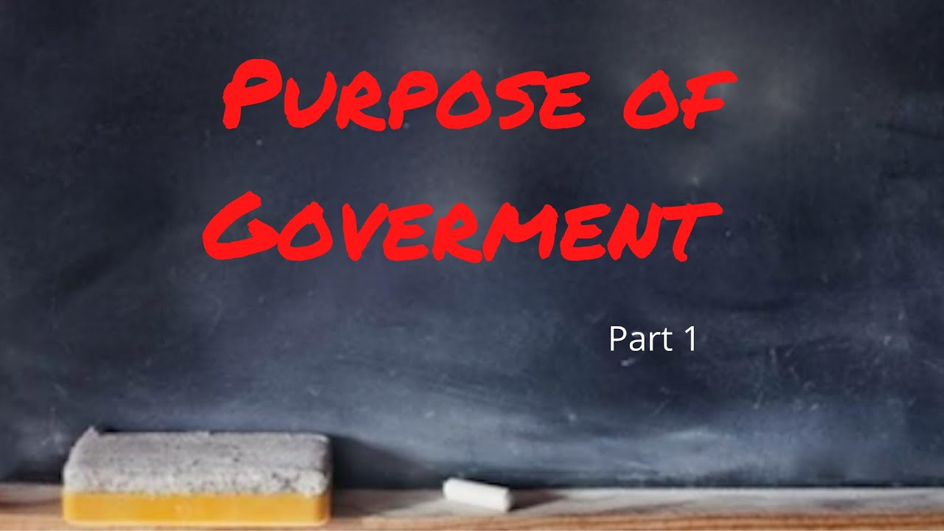
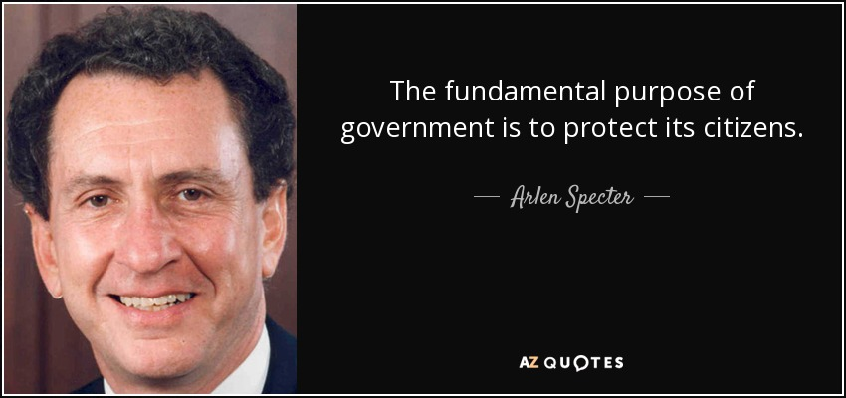

Slide 41
Purposes and Functions of Government
One of the central questions of political philosophy is the purpose of government.
Many great political philosophers have conceived themselves with this question.
One common formulation is that the main purpose of the state is to protect rights and to preserve justice.
In the contemporary world, however, the purposes and functions of governments have greatly expanded with the emergence of government as the most active force vehicle in the political, social, and economic developments.
Accordingly, the major purposes and functions of government include, among other things, the following:

Slide 42
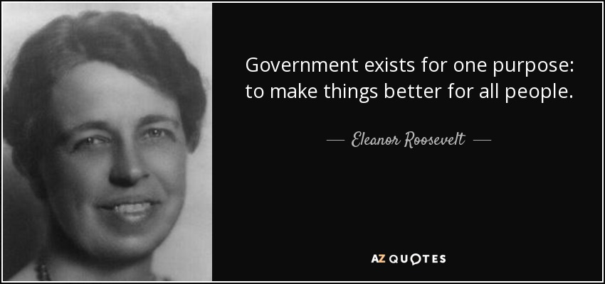

Slide 43
Self-Preservation: Nearly all governments at least claim to have as their purposes the establishment of an order that permits predictability, which in turn promotes a sense of security among the governed.
Sovereign states also take as a primary purpose the defense of the country‘s territory against external attack.
Thus, as their first and primary purpose and function, governments are responsible to prevail order, predictability, internal security, and external defense.
Distribution and Regulation of Resources: All governments invariably play the role of distributing resources in their societies.
In addition, governments are the only institutions that determine whether resources are going to be controlled by the public(Socialist) or private(Capitalist) sector.

Slide 44
Management of Conflicts: Governments usually develop and consolidate institutions and procedures for the management of conflicts.
These may include the legislative, executive, and judicial institutions with established procedures for the supervision and resolution of conflicts that may arise in the society.
Fulfillment of Social or Group Aspirations: Governments also strive to fulfill the goals and interests of the society as a whole and of various groups within the society.
It include the promotion of human rights, common good, and international peace.
Protection of Rights of Citizens: Governments, are established for the protection of every citizen‘s human, democratic, political, social, economic and cultural rights.
Constitutional and democratic governments are created to serve and protect every citizen‘s rights, not to dominate them.

Slide 45
Protection of Property: Governments provide means such as police and the court systems that protect private and public property.
Implementations of Moral Conditions: Some governments‘ attempts to improve the moral conditions of their citizens that is why, in all countries, laws and institutions are designed to shape citizens character in accordance with some standard of morality.
Provision of Goods and Services: Some governments, especially those of the poor countries, participate heavily in the provision of goods and services for the public.
Some of the necessary common goods and services provided by governments may include,
provision of healthcare, education, development of public works, provision of food, shelter, clothing for the public, Developing social services, etc.

Slide 46
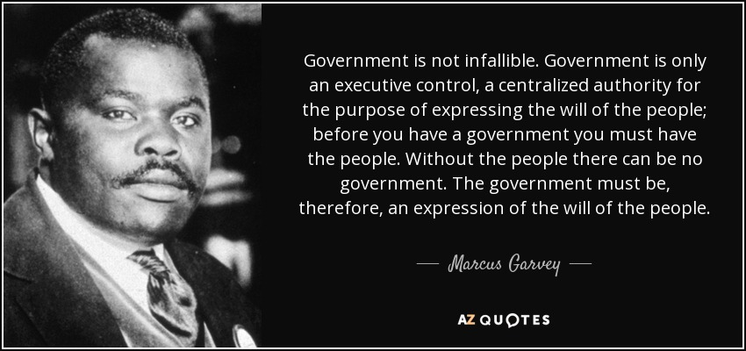

Slide 47
4.7. Understanding Citizenship
Defining Citizenship
What does the term citizenship means for you?
The means by which we determine whether a person is legal member of a particular State or otherwise is called ‘citizenship‘.
Citizenship simply denotes to the network of relationships between the State and the citizen.
It refers to the rules regulating the legal/formal relations between the State and the individual with respect to the acquisition and loss of a given country‘s nationality.
Citizen refers to the person who is a legal member of a particular State and one who owes allegiance to that State.
Citizen is a person who is legally recognized as member of a particular, officially sovereign political community, entitled to whatever prerogatives and encumbered with responsibilities.

Slide 48
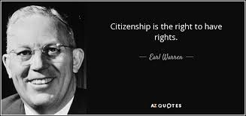

Slide 49
The concept of citizenship varies from society to society, depending on the place, the historical moment and political organization.
Although differences may exist, there are common elements such as rights, duties, belonging, identity and participation one can find in definitions of the term.
A. Citizenship as a Status of Rights: The mere fact of being a citizen makes the person a creditor of a series of rights.
Marshall 1998, distinguishes three types of rights that historically have been established in succession:
the civil, or the rights necessary for the development of individual liberty;
political, i.e. the right to participate in the exercise of political power, as an elected member or as a voter and
social rights, which are those that guarantee the right to public safety, health, the right to education, etc.,

Slide 50
Hohfeld (1978), for instance, discovered four components of rights known as the Hohfeldian incidents‘ namely:
liberty (privilege),
claim,
power and immunity.
Liberty Right: is a freedom given for the right-holder to do something and there are no obligations on other parties to do or not to do anything to aid the bearer to enjoy such rights. (FDRE Art 25-34)
Claim Rights: are the inverse of liberty rights since it entails responsibility upon another person or body( Article 41(3 and 4) of the FDRE)

Slide 51
Powers Rights: are rights regarding the modification of first-order rights.
They are cooperative controls that are imposed on others(Article 40(1) of the FDRE).
Immunity Rights: allow bearers escape from controls and thus they are the opposite of power rights.
Immunity rights entail the absence of a power in other party to alter the right-holder‘s normative situation in some way(Article 18(3) of the FDRE ).

Slide 52
B. Membership and Identity: Citizenship is associated with membership of a political community, which implies integration into that community with a specific identity that is common to all members who belongs to it.
The criteria for membership have been linked to:
shared territory,
common culture,
ethnic characteristics, history, etc.

Slide 53
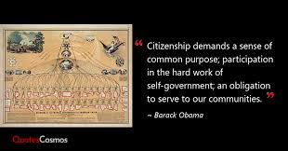

Slide 54
C. Participation: Participation occupies a key position in citizenship.
Nonetheless, individuals differ in what approaches they find important some people focus on their private affairs while others actively participate in the life of the society, including politics.
D. Inclusion and Exclusion: All individuals living in a particular state do not necessary mean that all are citizens.
For instance, there are non-citizens visiting, working and living in Ethiopia branded as foreigners/aliens.

Slide 55
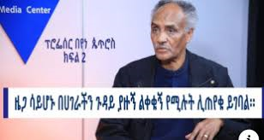

Slide 56
Theorizing Citizenship
Citizenship is not an eternal essence rather a cultural artifact mold by people through time and that is why the notion of citizenship and the meaning attached to it changes with the change in political thoughts, ideologies, policies and government.
Though there are different approaches to citizenship, most contemporary works that address the issue of citizenship speak of the following four approaches:
liberal,
communitarian,
republican and
multicultural citizenship.

Slide 57
Citizenship in Liberal Thought
Liberal theory of citizenship begins with the individual person (the self).
The self exists as the true symbol of liberal theory.
Accordingly, it gives a strong emphasis to the individual liberty of the citizen, and rights that adhere to each and every person.
The self is represented as a calculating holder of preferences and rights in a liberal society.
Hence, in liberalism the primary political unit as well as the initial focus of all fundamental political inquiry is the individual person.

Slide 58
Citizenship in Communitarian Thought
The debate on citizenship as the expression of community revived with the emergence of communitarianism since the 1980s.
Charles Taylor, Michael Sandel, Michael Walzer and Alisdair MacIntyre are some among the proponents of communitarianism.
Communitarianism is as an approach emphasizes on the importance of society in articulating the good.
The communitarian (also known as the nationalist) model argue that the identity of citizens cannot be understood outside the territory in which they live, their culture and traditions, arguing that the basis of its rules and procedures and legal policy is the shared common good.

Slide 59
All in all, the two defining features of communitarian perspective are:
First, no individual is entirely self-created; instead the citizen and his/her identity is deeply constructed by the society where he/she is a member.
Second, as a consequence of assimilation, a meaningful bond is said to occur between the individual person and his/her community.

Slide 60
Citizenship in Republican Thought
Republican citizenship theory put emphasis on both individual and group rights.
Means republican though attempts to incorporate the liberal notion of the self-interested individual within the communitarian framework of egalitarian and community belonging.
Citizenship should be understood as a common civic identity, shaped by a common public culture.
Republicans don‘t pressurize individuals to surrender their particular identities like the communitarian thought.
Instead, it is underpinned by a concern with individual obligation to participate in communal affairs.
It encourages people to look for the common ground on which they stand, despite their differences, as citizens.

Slide 61
Republicans, thus, acknowledge the value of public life.
Public life draws people out(out their talents and capacities), and.
It draws them together into community(into connection and solidarity, and occasionally conflict, with other members of the public.
In view of that, there are two essential elements of the republican citizenship: publicity and self-government.
Publicity basically refers to the condition of being open and public.

Slide 62
Multicultural Citizenship
Multicultural citizenship appropriate to highly diverse societies and contemporary economic trends.
Four principles of multicultural citizenship are:
Taking equality of citizenship rights as a starting point.
Recognizing that Formal equality of rights does not necessarily lead to equality of respect, resources, opportunities or welfare.
Establishing mechanisms for group representation and participation.
Differential treatment for people with different characteristics, needs and wants.

Slide 63
Modes/Ways of Acquiring and Loosing Citizenship
According UDHR Article 15 of the declaration, “everyone has a right to a nationality and that no one shall be arbitrarily deprived of his nationality”.
The grant of citizenship remains within the discretion of the state concerned, the means of acquiring a particular State‘s citizenship vary from country to country.
However, the common ways of acquiring citizenship can be grouped in to two:
citizenship by birth and
citizenship through naturalization/law.

Slide 64
Citizenship from birth/of Origin: individuals can get citizenship status of a particular State either because he/she is born in the territorial administration of his/her mother and/or father are citizens of the State in question.
That is, there are two principles of citizenship from birth commonly known as:
Jus Soli (law/right of the soil) and
Jus Sanguinis (law/right of blood).
Jus Soli is a principle whereby an individual is permitted to obtain citizenship status of a particular State because he/she was born in the territorial administration of that country,
Jus Sanguinis is a norm where citizenship acquired claiming one‘s parents(blood) citizenship status.
However, jus soli could not apply to children born from diplomats and refugees live in a host State.
Because of (international diplomatic immunities): extraterritoriality and inviolability principles.

Slide 65
Citizenship by Naturalization/Law: is the legal process by which foreigners become citizens of another country.
The common sub-principles of acquiring citizenship through naturalization are the following.
Political case (secession, merger and subjugation),
grant on application,
marriage,
legitimatization/adoption, and
reintegration/restoration.

Slide 66
Citizenship by political case is a process by which an individual person acquires citizenship of a certain State following the conquest or cession of a territory.
In case a particular territory is merged to or subjugated by another country, people domiciled in that territory would acquire a new citizenship.

Slide 67
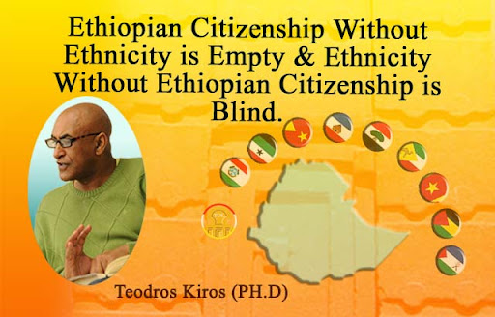

Slide 68
The Modes of Acquiring Ethiopian Citizenship
Before the 1930, there wasn‘t officially inscribed legal document that deals with citizenship. But in 1930 Ethiopia adopted a legal document named as “Ethiopian Nationality Law”.
Recently, this nationality law has replaced by another legal document called “Ethiopian Nationality Proclamation” NO. 378/2003 which was adopted in 2003 by the House of People‘s Representatives.
This proclamation is enacted in accordance to article 6 and 33 of the 1995 FDRE constitution and affirmed that
a person can acquire Ethiopian citizenship either by birth or naturalization.

Slide 69
Acquisition by Descent: the 1930 Ethiopian nationality law asserted that “any person born in Ethiopia or abroad, whose father or mother is Ethiopian, is an Ethiopian subject”.
In its Article 6(1), the 1995 FDRE constitution stated that “any person of either sex shall be an Ethiopian national where both or either parent is Ethiopian”.
Acquisition by Law (Naturalization): Article 6(2) of the 1995 FDRE constitution also avers that aliens can get Ethiopian citizenship.

Slide 70
A) Grant on Application (registration): happens when an alien requests a host state to be granted citizenship status of the country in question.
B) Cases of Marriage: an alien who is married to an Ethiopian citizen have the possibility of acquiring Ethiopian citizenship.
C) Cases of Adoption (Legitimating): this process whereby an illegitimate child get citizenship status of his/her caretaker‘s nationality.
D) Citizenship by Special Cases: as it is labeled in Article 8, an alien who has made an outstanding contribution in the interest of Ethiopia may be conferred with Ethiopian nationality by law without undergoing the pre-conditions stated

Slide 71
E) Re-Admission to Ethiopian Nationality (Reintegration/Restoration): this is a process by which a person acquires his/her lost citizenship.
A person who has lost Ethiopian citizenship status may get back Ethiopian nationality.
Dual Citizenship
Dual citizenship is the condition of being a citizen of two nations. Of course, a person may acquire more than two States which is called multiple citizenship.
Duality/multiplicity arises because of the clash among the Jus Soli, Jus Sanguinis and naturalization.

Slide 72
For example, a baby born to a French family visiting the United States would acquire U.S. citizenship by Jus Soli and French citizenship by Jus Sanguinis.
A child born from a mother and father of two different countries could acquire dual citizenship through decent.
Ethiopia prohibits its citizens to have dual citizenship.
Article 20(1) of the 2003 nationality proclamation assert that “any Ethiopian who voluntarily acquires another nationality shall be deemed to have voluntarily renounced his Ethiopian nationality”.

Slide 73
Ways of Loosing Citizenship
Citizenship can be lost when a State provides for lapse or withdrawal of citizenship under certain conditions, or when a citizen voluntary renounces it.
The primary rational for loss of citizenship is the absence of a genuine link with the state.
The commonly discussed ways of losing citizenship are:
deprivation,
renunciation,
lapse/expiration and
substitution.

Slide 74
Deprivation is an involuntary loss of citizenship which arises while government authorities or court take a decision to nullify an individual‘s citizenship.
It is on the assumption that the burden of justification for the loss of citizenship of an individual lies on the state.
The citizen may be deprived of his/her citizenship for reasons of:
uncovering national secrets,
non-compliance with citizenship duties (duty of loyalty),
loss of genuine link with his/her state,
flawed acquisition of citizenship,
promising loyalty to and/or serving in armed force of another country, trying to overthrow the government by force,
becoming naturalized in another country.

Slide 75
Lapse/expiration is another way of losing citizenship which is not applicable to Ethiopia.
Lapse is a mode whereby a person loses his/her citizenship because of his/her permanent residence or long term residence abroad beyond the number of years permitted by the country in question.
For example, if an Indian citizen stays outside his/her country continuously for more than seven years, he/she automatically loses his/her Indian nationality by the principle of lapse.

Slide 76
Renunciation is the voluntary way of losing citizenship.
The UDHR (1948) guarantees the right of a person to change his/her nationality.
Loss of citizenship is voluntary only if it is intended and initiated by the individual concerned.
An Ethiopian national has the full right to renounce his/her Ethiopian nationality if he/she wishes according to Article 33(3) of the FDRE constitution and Article 19 of the 2003 Ethiopian nationality proclamations.

Slide 77
Substitution: citizenship may be lost when the original citizenship is substituted by another state, where it is acquired through naturalization.
On the other side, this may also take place when a particular territory is annexed by another state; the inhabitants‘ citizenship within the annexed territory will be replaced by the citizenship of the subjugator.
Statelessness
Statelessness is the condition of having citizenship of any country and with no government from which to ask protection.
According to the international law, stateless person is a person who is not considered as a national by any state under the operation of its law.

Slide 78
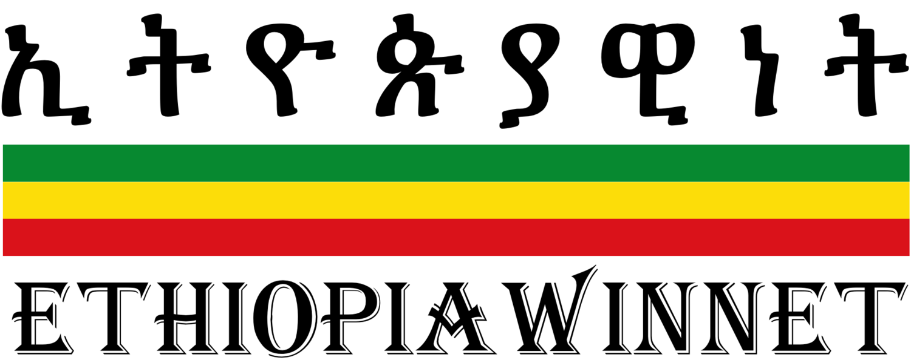
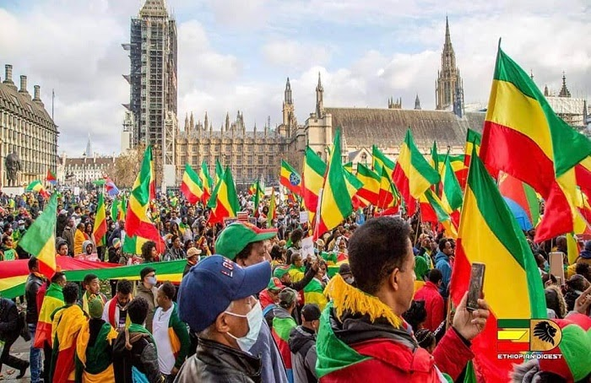
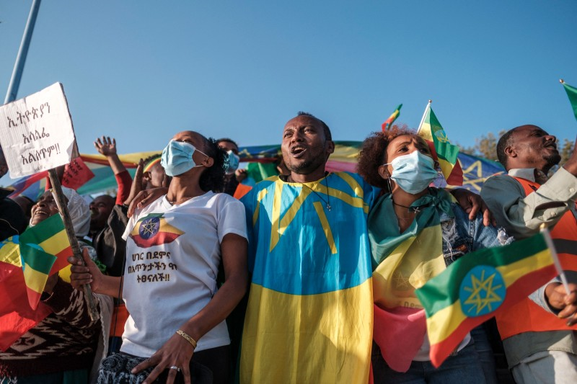

Slide 79


Slide 80


Slide 81


